Slide 1
MUSTANG MEDICINE
REWILDING
the path to inner peace
WWW.MUSTANGMEDICINE.COM

Slide 2
MUSTANG MEDICINE
Page / 02
About Us
Goals & Intentions
The Experience
The Knowledge
Meet the Team
What People Say
The Invitation
Upcoming Events
Contact Us
OVERVIEW

Slide 3
MUSTANG MEDICINE
Finding your Center
You Are the Medicine
Page / 03
MUSTANG MEDICINE

Slide 4
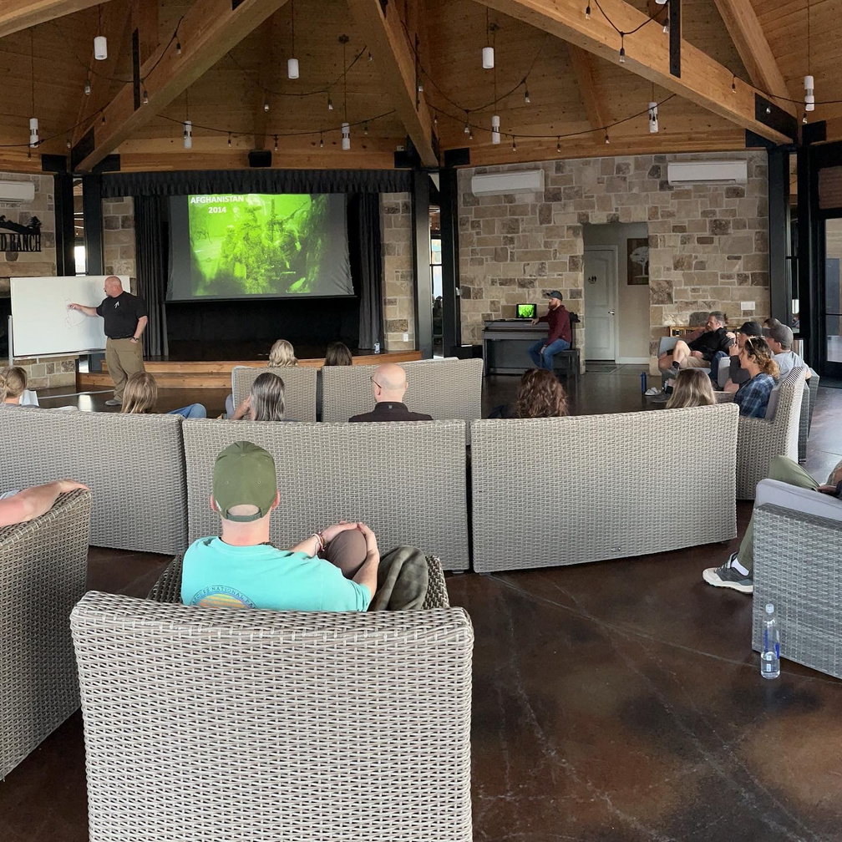
About Us
ReWilding is an immersive experience that combines scientific knowledge and thousands of hours of cross-disciplinary research into classes and activities to help students navigate their emotions, regulate their nervous system, and chart a path to healing and growth.
Through education, hands-on experience, and community, the ReWilding retreat provides a map to discover who you are and why you do what you do. At ReWilding, students are taught tools and practices to take home to their family and personal life to maintain their center.
MUSTANG MEDICINE
Page / 04

Slide 5
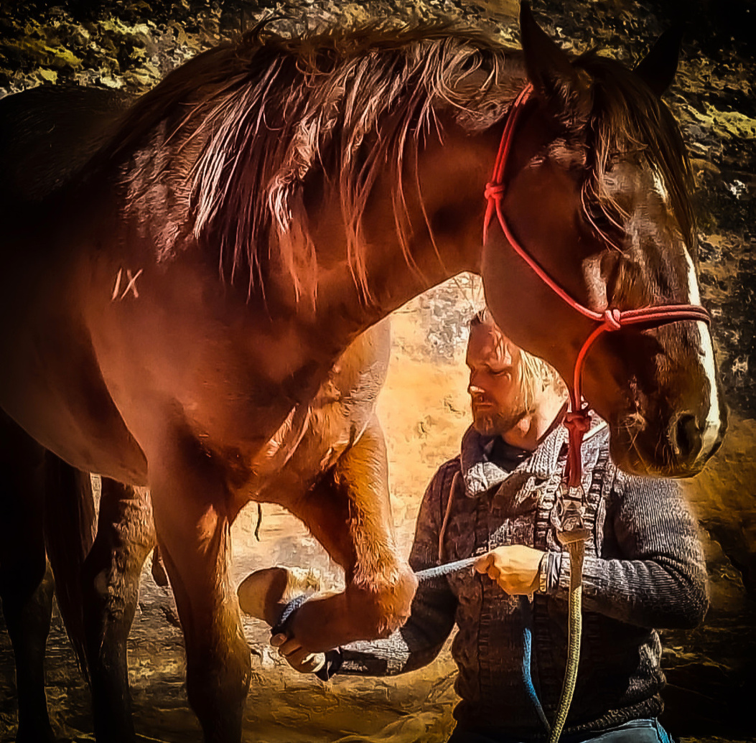
Our Goals & Intentions
Mustang Medicine provides guided support to individual’s seeking to find their center so they can repair and improve relationships with themselves, families, and communities.
We share tools and practices that regulate the nervous system. We provide knowledge to better understand how to find authenticity, vulnerability, and accountability within ourself and our relationships. Through our Mustang Medicine journey, we will demonstrate that You Are The Medicine.
MUSTANG MEDICINE
Page / 05

Slide 6
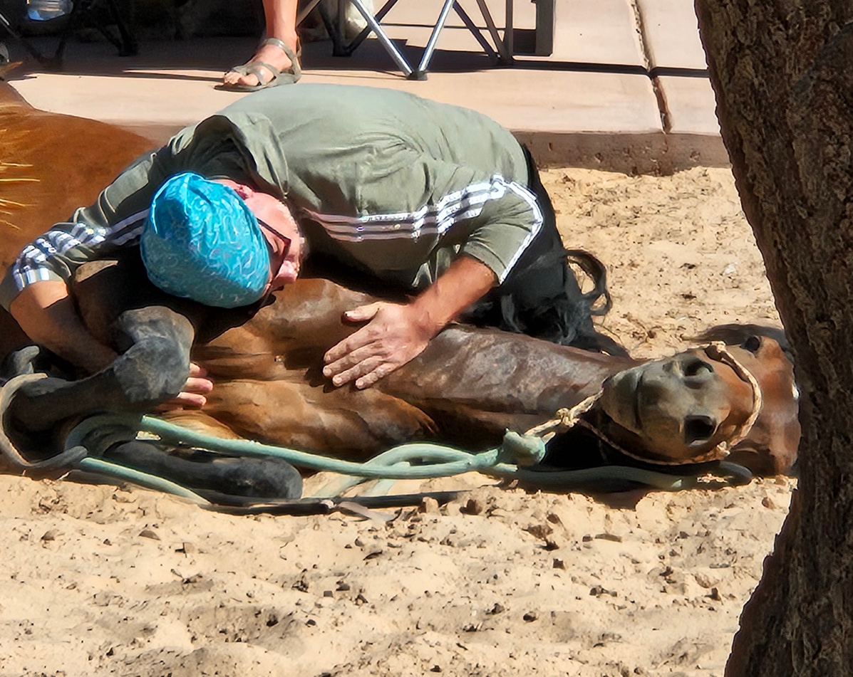
The Experiences
Are designed to regulate the nervous system and teach emotional resiliency through symbolism, mindset, and intention
Opening
Ceremony
Cold Water Practice
Heat Sauna
Practice
Where we set our intention & a mindset where we can be authentic, vulnerable and accountable
A modality that allows you to negotiate with your nervous system and sink deeper into yourself
An experience to open the heart & mind while the body releases toxins
Wild Horse
Ceremony
Holotropic Breathwork
Closing
Ceremony
The horse is the mirror to the soul and all of our shadow and shine
The experience that returns us back to ourselves so we can find our center and understand our patterns
The culmination of experiences and recognition of our return to ourselves and our center
Page / 05

Slide 7
The Knowledge
Mustang Medicine balances experiences and emotions with the “why” and the science behind our behaviors. This goes beyond just feeling; giving us the knowing and understanding of why our physical, psychological, and emotional selves acts the way they do.
During ReWilding, students are exposed to knowledge about Core Wounded Beliefs, Emotional and Behavioral Triggers, Connected Relationships, and the Three Pillars of Resiliency so they can turn their traumas into their teachers.
MUSTANG MEDICINE
Page / 05

Slide 8
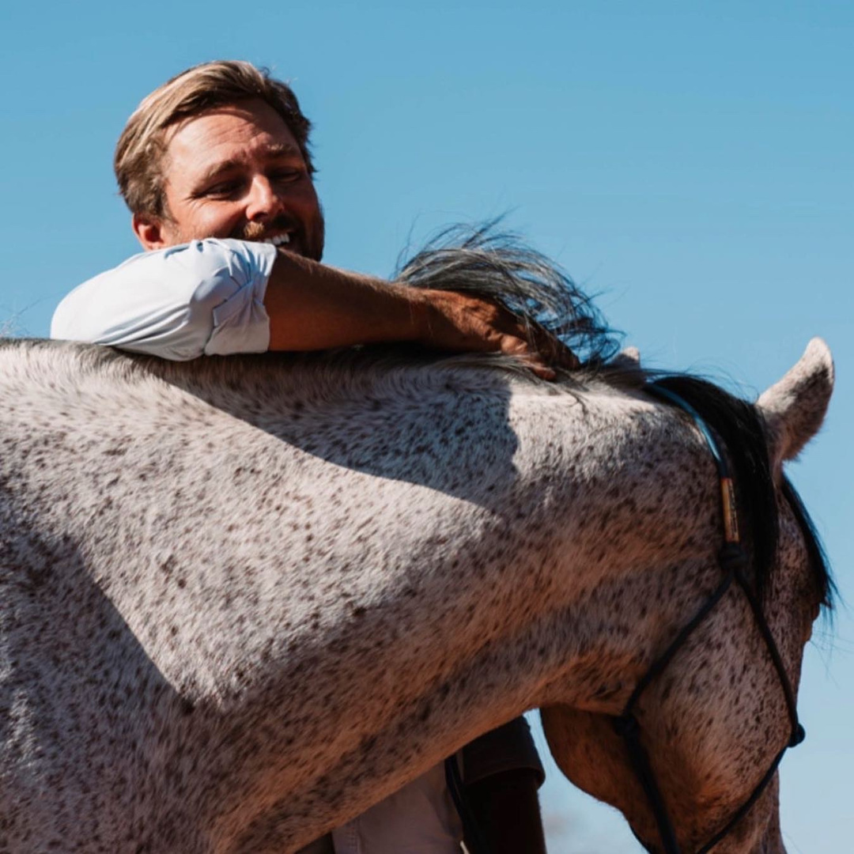
Hugh Vail
Inspired by William Wilberforce, who was pivotal in abolishing the transatlantic slave trade, and motivated by his work with organizations combating child sex trafficking, Hugh co-founded the Clapham Foundation in 2017
After experiencing personal losses and suffering, Hugh embarked on a journey to understand and address loss, grief, sorrow, pain, and depression. He recognized the common tendency to turn these fragmented perspectives into unhealthy habits. Determined to make peace with his own challenges, Hugh sought to combat shame, guilt, and trauma in a way that could help him and others transform pain into something meaningful. In partnership with his dear friend and kindred spirit Jeff, Mustang Medicine was born.
Hugh became motivated to share his story after realizing that his experiences were more common than he had thought and that his story could resonate with a wide variety of people.

Slide 9
Jeff Kirkham
Jeff Kirkham brings a wealth of experience and unparalleled expertise to ReWilding. With 28 years of service as a Green Beret, Jeff has honed his ability to regulate the nervous system under the most stressful conditions. As an inventor of several patents, including the RATs tourniquet, and a co-founder of Black Rifle Coffee Company, Jeff has demonstrated a unique blend of innovation and entrepreneurial spirit.
In addition to his military and business achievements, Jeff is a best-selling co-author of the Black Autumn book series, as well as numerous other books, sharing his extensive knowledge and experiences with a broad audience. Jeff is also a Registered Nurse (MSN), and currently completing an additional master's degree in psychology, which underscores his commitment to health and wellness.
As the co-founder of Mustang Medicine, Jeff has facilitated over 20 wellness retreats, helping participants find their center and learn practical tools for nervous system regulation. His decades of teaching experience and deep understanding of stress management make him an exceptional guide for those seeking to improve their well-being.

Slide 10
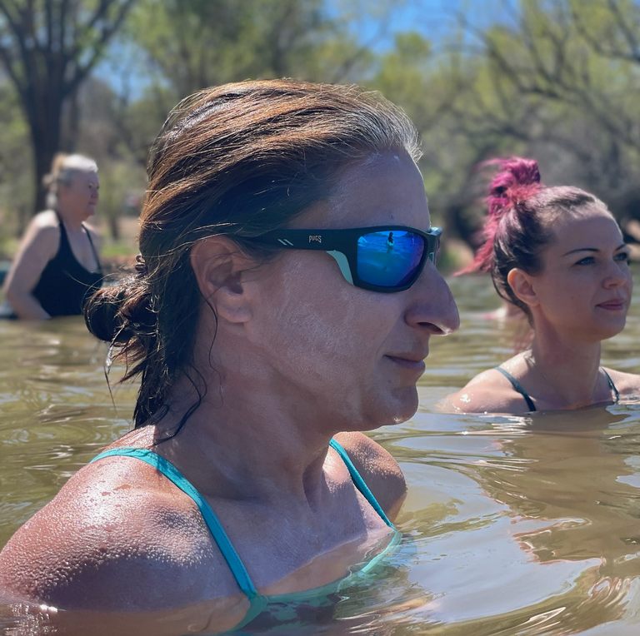
Robyn Kirkham
Robyn Kirkham has lived a lot of lives in just this one trip to our planet. From Army, to law enforcement; from to intel, to soccer mom, Robyn served our country, ran start-up businesses, managed a family, and did all the "doings" expected of a type-A, high achiever.
Despite her career successes and surface-level accomplishments, she realized that things were missing in her life that she felt ill-equipped to understand or address. To identify the root causes of her type-A, over-achieving, emotionally limiting behaviors, Robyn embarked on a personal journey to understand her traumas, triggers, and patterns and make meaningful changes to find her center.
Robyn shifted focus and is completing a Masters in CyberPsychology, with a focus on victimization and criminal profiling. With the Mustang Medicine team, she helped establish and facilitate the ReWilding retreats where she serves as both a student and a guide, building community through shared experiences and emotional and informational intelligence. Robyn works with people to develop connected relationships through authenticity, vulnerability, and accountability (AVA).

Slide 11
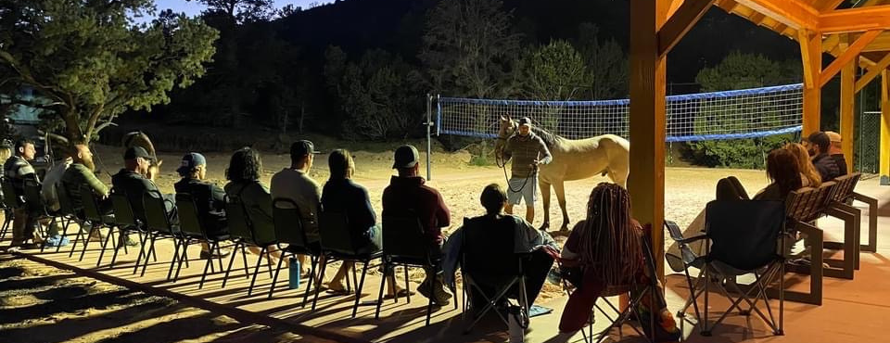
“Each of you have enriched my life so much.I’m so grateful for the strength of you give me... Can’t wait to continue to be authentic, vulnerable and accountable.”
Ben M.
What people say...
“”I tried to explain to my firefighters about this weekend and I’m stuck at amazing! It will take time to unpack what just happened to me.”
Jeff Adams
MUSTANG MEDICINE
Page / 10

Slide 12
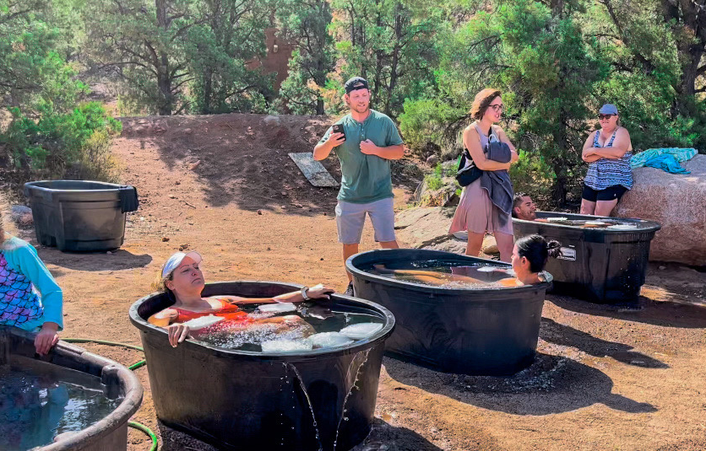
THE INVITATION
Over the last 3 years we have been able to help over 500+ people to regain their center; many of whom arre in the veteran & first responder communities.
Through the combination of our ReWilding immersive experience and guided support, we help people find a path back to themselves and remember their true power.
We are currently exploring partner organizations who share our same values to expand our reach and impact.

Slide 13
UPCOMING
ReWilding
REWILDING 16
EVENTS
July 20-23, 2024
REWILDING 17
August 8-11, 2024
REWILDING 18
September 26-29, 2024
REWILDING 19
MUSTANG MEDICINE
October 24-27, 2024
Page / 13

Slide 14
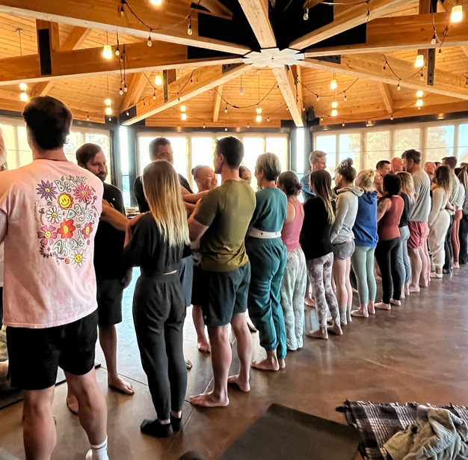
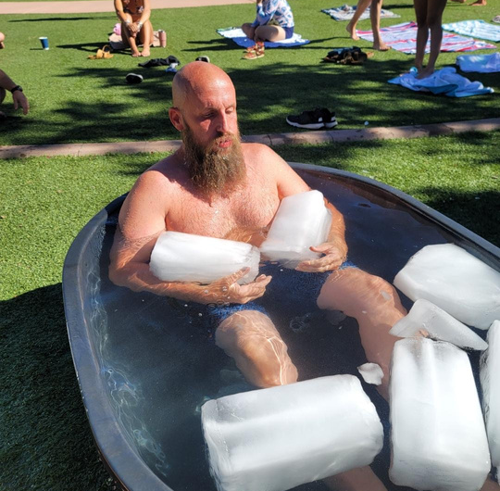
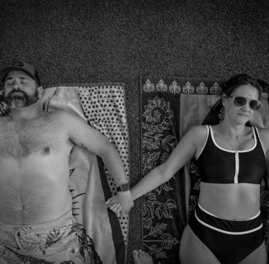
ReWilding
IMMERSIVE EXPERIENCE
Hosted at The Holmstead Resort in picturesque Southern Utah, our 4-day experience is fully immersive . Guests will enjoy private cabin accommodations, healthful food, support of a community and deeply connecting experiences carefully curated from years of exploration. The end result is one of transformation, growth and unlocking one’s potential.
Group Facilitation
Daily Cold Plunge
& Yoga
Mustang Lay Down Ceremony
Breathwork
MUSTANG MEDICINE
Page / 14

Slide 15
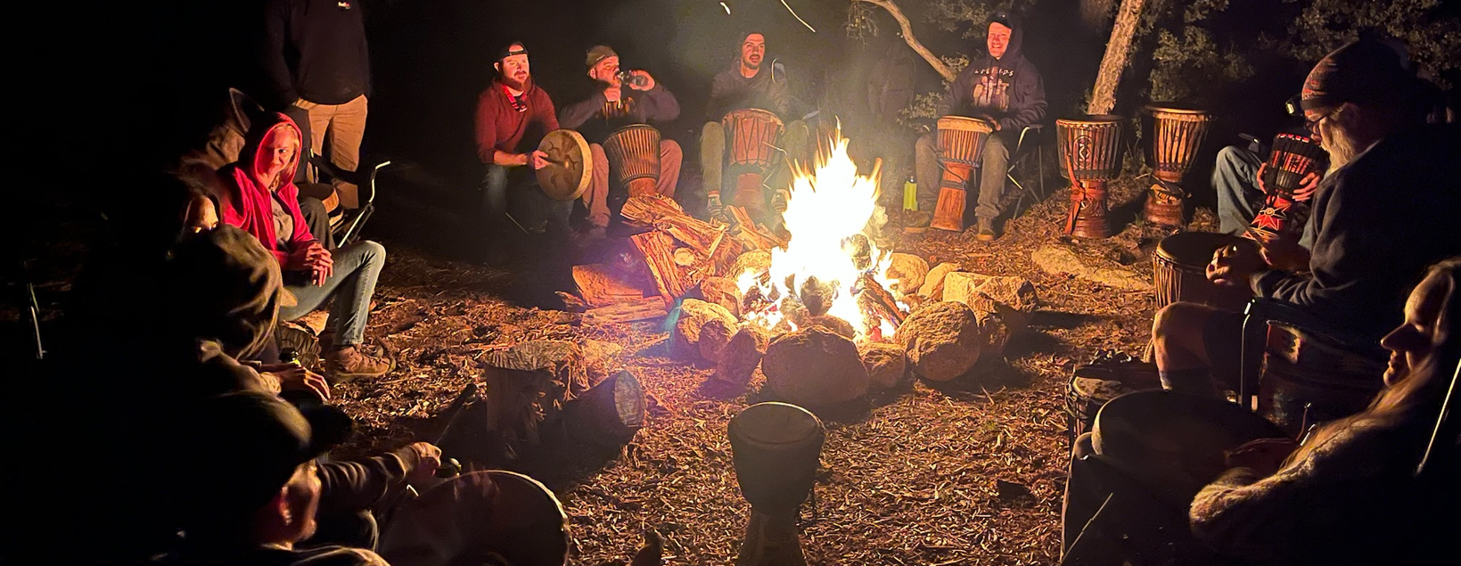
CONTACT US
571-251-6567
INFO@MUSTANGMEDICINE.COM
MUSTANGMEDICINE.COM
Page / 16

Slide 16
THANK YOU
MUSTANGMEDICINE.COM

